Slide 1
Today
Lecture 2: Defining properties of superconductors
Explore the properties that define the superconducting state:
Zero resistance
Limits to superconductivity: critical temperature, critical magnetic field, critical current
Perfect diamagnetism --- the Meissner effect
Limits to the Meissner effect:
(a) penetration depth
(b) vortices --- Type II superconductivity
(c) anisotropy --- pancake vortices
(d) geometric effects --- Intermediate state
(e) surface superconductivity
Thursday
Lecture 3: Models and theories of superconductivity

Slide 2
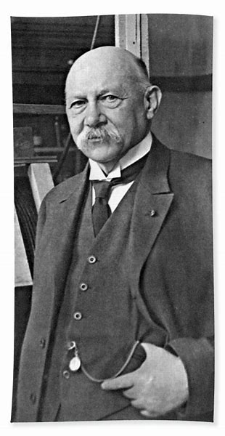
Basic properties of SCs:
ZERO ELECTRICAL RESISTANCE – primary defining property; one of the hardest to explain
* Discovery: Heike Kamerlingh Onnes Leiden 1911 (April)
First to liquefy helium
Discovered:
$Au, Pt$were not $SC$
$Hg, Pb, {Sn}_{ }$ were $SC$
Defined critical temperature
Defined critical magnetic field
Defined critical current
Found that the impurity content was not important
(Anderson Theorem 1959)
Named it SUPRA-CONDUCTIVITY
Studying normal metal conductance $R vs. T$
$$Si$$
$\sim T$(phonons)
$Si$turns up
$Pt$ leveled off
$Au  0$gradually
$H_{g}  0$ abruptly
$$R$$
$$Pt$$
$$Au$$
$$Hg$$
$$T$$
Good experimentalist – 1st observed phenomenon, then tried to the understand behavior.
History of Discovery:
IEEE Trans. Magnetic 23 (1987) -- 75th Anniversary
Physics Today 63, 9, 38 (2010) --- 100TH Anniversary
* Nobel Prize 1913

Slide 3
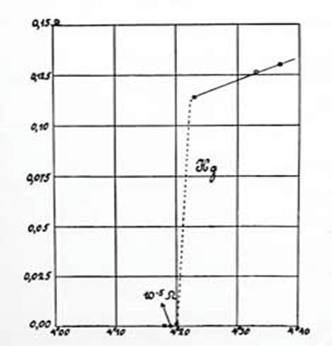
Two key questions:
1. How “zero” is the resistance?
R
$$H_{g }$$
$ρ\left(300K\right) \sim {10}^{−4}\text{Ω−}\text{cm}$
$$ρ\left(0K\right)< {10}^{−12} \text{Ω−}\text{cm}$$
factor of ${10}^{8}$ lower
→
really small
For comparison, “pure”
$$Cu ρ\left(0K\right) \sim { 10}^{−10}\text{Ω−}\text{cm}$$
Advanced experiments to test $ρ$
SC ring
$$⟹$$
$$L$$
$$R$$
τ $=$ $\frac{L}{R}$
Best result: Pb $ρ\left(0K\right)< {10}^{−25} \text{Ω−}\text{cm}$
$ρ\left(300K\right) \sim {10}^{−5}\text{Ω−}\text{cm}$
$$L \frac{dI}{dt}+RI=0 ⟹ I\left(t\right)=I\left(0\right){ e}^{−\left(\frac{R}{L}\right)t}$$
Apply magnetic field to induce a circulating current and monitor the decaying field in the loop for as long as you are willing to wait
factor of ${10}^{20}$ lower!
→
It’s really zero!
2. How sharp is the transition? --- is it an abrupt or a gradual change
Depends on purity and homogeneity
Broadened by magnetic fields and fluctuations
Best results $∆T< {10}^{−5} K$!

Slide 4
Found this arXiv paper that purports to have proven that the resistance is exactly zero --- not sure, it does not seem to have ever been published

Slide 5
2. CRITICAL TEMPERATURE/MAGNETIC FIELD/CURRENT
$SC d$estroyed by temperature $Tc$
critical temperature
$SC$destroyed by magnetic field $Hc$
critical field
$$H$$
$$H_{c}\left(G\right)$$
$$H_{c_{2}}$$
$$1000$$
$$N$$
$$Pb$$
$$H_{c_{1}}$$
$$Hc\left(T\right)=Hc\left(0\right)\left[1−{\left(\frac{T}{Tc}\right)}^{2}\right]$$
$$Sn$$
$$Hg$$
$$Hc ≈100 G/K$$
$$100$$
$$In$$
$$Ba$$
$$SC$$
$$Ti$$
$$T$$
$$10$$
$$T_{c}\left(k\right)$$
$$T_{c_{1}}$$
$$T_{c_{2}}$$
$$0.1 K$$
$$1K$$
$$10K$$
$SC$ destroyed by current flow $Ic$
critical current
“Silsbee rule” - wire becomes normal when field at the surface reaches H_{c}
I
$$B=\frac{μ_{0}I}{2πr} ⟹$$
$$I_{c}=2πr{H_{c}}/{μ_{0}}$$
B
[not strictly true --- as we will see, geometry & microscopic effects “pairbreaking” --- play a big role as well]

Slide 6
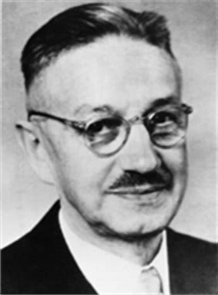
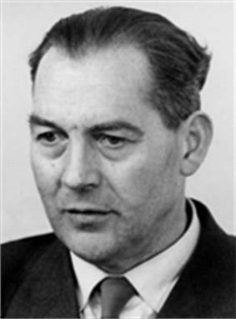
PERFECT DIAMAGNETISM ( $\overset{⃑}{B}=O$)
Magnetic field excluded from $SC$
Discovery : Walther Meissner and Robert Ochsenfeld 1933
“Meissner effect”
This was a surprise – why?
Consider a perfect conductor $ρ =O ⇒\overset{⃑}{ E}=0$
$$\overset{⃑}{∇}×\overset{⃑}{E}=−\frac{d\overset{⃑}{B}}{dt}=O ⟹ \frac{d\overset{⃑}{B}}{dt}=O$$
Meissner
Ochsenfeld
Maxwell’s equations :
$∴ \overset{⃑}{B} =$ constant
$$T<T_{c}$$
$$T>T_{c}$$
$$T<T_{c}$$
$$T>T_{c}$$
FINITE
FIELD-COOLED
ZERO FIELD-COOLED
$$H<H_{c}$$
$$⇐$$
$$H <H_{c}$$
$$⇒$$
$$H$$
$$⇓$$
$$⇑$$
$$H$$
$$⇑$$
$$⇓$$
field trapped in
$$O$$
$$⇒$$
field excluded
$$O$$
$$⇐$$
$$O$$
$$ρ$$
$$O$$
$$ρ$$
$$T$$
$$T$$
For a perfect conductor, the state below $Tc$ depends on the history of the cooling
For a superconductor, the state below $Tc$ behaves as zero-field cooled always! $\overset{⃑}{B}=0$inside $SC$ (not only ρ $=0)$

Slide 7
Describe state as a PERFECT DIAMAGNET :
$$\overset{⃑}{B}=μ0\left(\overset{⃑}{H}+\overset{⃑}{M}\right)$$
$$\overset{⃑}{B}=\overset{⃑}{H}+4π\overset{⃑}{M}$$
[MKS]
[cgs]
$$\overset{⃑}{B}=0 ⟹\overset{⃑}{M}=−\frac{1}{4π} \overset{⃑}{H}$$
$\overset{⃑}{B}=0 → \overset{⃑}{M}=− \overset{⃑}{H}$
$$−M$$
$$B$$
$$SC$$
$$N$$
$$SC$$
$$N$$
$$H_{c}$$
$$H_{c}$$
$$H$$
$$H$$
Two possible descriptions to give these field behaviors:
(1) perfect diamagnetic material (local)
(2) screening supercurrents flow to screen fields (global)
 this picture has some advantages for energy calculations
 this is the accurate physics description

Slide 8
4. MAGNETIC FIELD PENETRATION
What we have discussed almost never occurs --- fields penetrate superconductors for many reasons:
(a) Penetration depth
Effective diamagnetism caused by screening currents that flow over a finite thickness near edge
“penetration depth” $λ=\sqrt{\frac{m}{{ne}^{2}μ0}}$
Fields penetrate into sample over this distance --- we will characterize this phenomenon in various electrodynamic and microscopic theoretical models

Slide 9
(b) Type II superconductivity Shubnikov (experiments); Abrikosov (theory)
Most $SC$are Type II and allow flux penetration in discrete “vortices” of magnetic flux
Type I $SC$ : elements $<$ 1% of all superconductors
Type II $SC$ : alloys, compounds, thin films, dirty materials, disordered, unconventional, ..…
*Important – allows $SC (R=0)$ at fields well above the 100 g/K region
(if NbTi were type I, Hc $\sim$1 KG instead of > 10 T)
$×100$
Key : surface energy positive (Type I) or negative (Type II) --- we will study the theory in depth
interface between N and S regions

Slide 10
Phenomena:
1. Two critical magnetic fields ( $Hc_{1}$, ${Hc}_{2}$ )
$$SC$$
$$SC$$
$Hc_{1 }$ field starts to penetrate
$Hc_{2}$ field fully penetrates (normal state)
Meissner
state
Abrikosov state
Mixed state
Vortex state
$$N$$
$$−M$$
$$H$$
$$H_{c_{1}}$$
$$\left(H_{c}\right)$$
$$H_{c_{2}}$$
$$H_{c_{2}}$$
$$N$$
$$V$$
$$H_{c_{1}}$$
$$B$$
$$M$$
$$T$$
$$H_{c_{1}}$$
$$\left(H_{c}\right)$$
$$H_{c_{2}}$$
$$T_{c}$$

Slide 11
2. H_{c2} field scale can be much larger
$Tc$ $Hc2$
$6K$ $PbIn$ $0.2 T$
$10K$ $NbTi$ $13 T$
$18K$ $Nb_{3}S_{n}$ $23 T$
$15K$ ${ PbMo}_{6}S_{8}$ $60 T$
$90K$ $YBCO$ $\sim 100 T ?$
$${−H}_{c}$$
60
$$PbMo6S_{8}$$
40
$$Nb_{3}Ge$$
$$Nb_{3}S_{n}$$
20
$$Nb{Ti}_{ }$$
$$Pb{In}_{ }$$
$$T_{c}$$
10
20

Slide 12
Vortex state (H$c_{1}<H_{2}<Hc_{2}$)
$$Φ_{0} \text{=}\frac{ h}{ 2e}$$
Triangular lattice of vortices of flux $Φ_{0}$
= $2.07 ×{10}^{−7} G−cm2$
= $2.07 ×{10}^{−15} Wb$
$$S$$
$$n=\frac{B}{Φ_{0}}$$
$$H$$
$$↑$$
$$s= {\left(\frac{2}{\sqrt{3} n}\right)}^{1/2}$$
Maximize interface area subject to flux quantization constraint

Slide 13
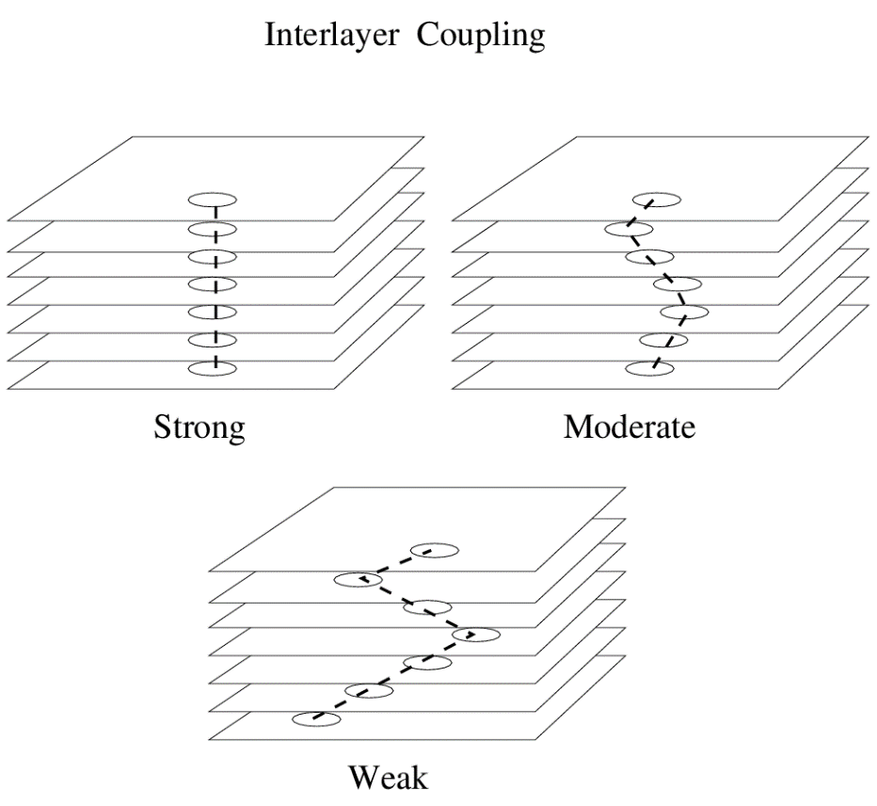
(c) Anisotropic materials
HTSC are very anisotropic --- layered materials with weak interlayer coupling
This allows vortices to decouple between layers, giving rise to a complex vortex phase diagram
Irreversibility
melting
Vortex
liquid
$$H_{c_{2}}?$$
Vortex
Lattice
(Vortex Glass)
Normal
Abrikosov vortices in bulk material
$$H$$
Vortex
liquid
$$H_{c_{1}}$$
Meissner
$$T$$
$$T_{c}$$
Pancake vortices in layered material
See review by Blatter et al.

Slide 14
(d) Geometric effects --- the intermediate state
Screening of fields is affected by the geometry of the sample → demagnetizing effects
Consider a SC sphere:
$$Z$$
Inside: $\overset{⃑}{B}=0 = \overset{⃑}{H}+4π\overset{⃑}{M}$
Outside:$\overset{⃑}{∇}∙\overset{⃑}{B}=0$ $\overset{⃑}{∇}×\overset{⃑}{B}=0$
B.C:$B→Ha as r → ∞$
$\overset{⃑}{B}∙\hat{n}=O r=R$
$H_{t}$ continuous $at r=R$
$$r$$
$$θ$$
$$H_{a}$$
$$R$$
OUTSIDE: $\overset{⃑}{B}=\overset{⃑}{H}a+\frac{{HaR}^{3}}{2}\overset{⃑}{∇}\left(\frac{cosθ}{r^{2}}\right)=\overset{⃑}{H}$
INSIDE: $\overset{⃑}{B}=O$ $\overset{⃑}{H}=\frac{3}{2}Ha \overset{⃑}{M}=−\frac{3}{8π}Ha$
$$+$$
$$=$$
UNIFORM
DIPOLE
RESULTANT

Slide 15
Demagnetizing Factor D
For ellipsoidal sample:
$$\frac{1}{3}$$
$$b$$
$$a$$
$$→H_{a}$$
$$D=\left(\frac{1}{e^{2}}−1\right)[\frac{1}{2e}\ln\left(\frac{1+e}{1−e}\right)−1]$$
$$D$$
$$e$$
where e = $\frac{a−b}{a+b}=$ eccentricity
$$0$$
$$1$$
In general, Define demagnetizing factor for each shape:
$$H_{a}$$
$$D=1$$
$$D=1/2$$
$$D=1/3$$
$$D=0$$
$$\overset{⃑}{B}=\overset{⃑}{H}+4π\overset{⃑}{M}$$
$$\overset{⃑}{B}=0$$
(inside)
$$\overset{⃑}{H}=Ha−\left(4πM\right)D$$
$$\overset{⃑}{H}=\frac{Ha}{(1−D)}$$
(inside)
$$\overset{⃑}{M}=−\frac{Ha}{4π(1−D)}$$
(outside)

Slide 16
Since H_{t} continuous, $H_{eq} = B_{eq}=H$ inside
Look at equator:
$$H_{eq}= \frac{H_{a}}{1−D}> H_{a}$$
for D>0
Turn up applied field, $H_{eq}$ >> $H_{c}$ before $H_{a} = H_{c}$
PARADOX: system cannot stay SC $(H>Hc \underset{⇒}{ } N)$
system cannot go N (field penetrates so that H = H_{a} < H_{c} $\underset{⇒}{ } SC)$
edge cannot go N (still same problem)
SOLUTION: system breaks up into N and S longitudinal
INTERMEDIATE STATE (between the Meissner and Normal states)
(like vortex state since flux penetrates but tries to minimize rather than maximize the amount of surface)

Slide 17
Field range:
MEISSNER INTERMEDIATE NORMAL
$$H_{a}$$
$$0$$
$$\left(1−D\right)H_{c}$$
$$H_{c}$$
Fields:
$$− \frac{H_{c}}{4π}$$
In $S:$ $B= O$ $H = H_{c}$ $M =$
In $N:$ $B=H=H_{c}$ $M = O$
(if more or less, interface would move as material goes $N↔S$)
Fraction of N material $\left(≡η\right)$:
$$1$$
Conserve flux through sample to determine $$:
$$S$$
$$I$$
$$N$$
$D=1: \left\langle B\right\rangle =η H_{c}= H_{a} ⟹ $
$$= \frac{Ha}{Hc}=\frac{wN}{wN+wS}$$
$$η$$
$$w_{N} w_{S}$$
$$H_{a}$$
$$\left(1−D\right)H_{c}$$
$$H_{c}$$
$$D<1: \left\langle B\right\rangle ={ηH}_{c}=\left[H_{a}−\left(1−D\right)H_{c}\right]/D⟹$$
$$= \frac{Ha−\left(1−D\right)Hc}{DHc}$$

Slide 18
Derivation of $$ expression :
Consider sample as having an “average” magnetization <M> less than perfect diamagnetism value:
$$H=Ha − 4π<M>D=Hc \underset{⇒}{ } < M> =$$
$$\frac{1}{4π} \frac{Ha−Hc}{D}$$
Compare to <M> in laminar structure:
0
$$<M> = η <MN> +\left(1−η\right)<MS>$$
$$=− \frac{1}{4π}\left(1−η\right)H_{c}$$
$$\frac{1}{4π} \frac{Ha−Hc}{D}$$
$$\frac{H_{a}−\left(1−D\right)H_{c}}{DH_{c}}$$
$$\left(η−1\right)Hc=$$
$$⇒η=$$

Slide 19
Magnetic Properties (averaged properties)
$$H_{c}$$
$$\left\langle B\right\rangle$$
$$<B> =\left(1−η\right)0+ηH_{c}=ηH_{c}$$
$$H_{a}$$
$$S N$$
$$H_{c}$$
$$<H> =H_{c}$$
$$H_{a}$$
$$<M> = <B><H> =\left(η−1\right)H_{c}$$
$$H_{c}$$
$$−4π\left\langle M\right\rangle$$
$$H_{a}$$
$$\left(1−D\right)H_{a}$$
$$H_{c}$$
$$H$$

Slide 20
Intermediate state in Type II $SCs$
Same effects below H${c1}_{ }$ – distorts magnetization
$$−4π\left\langle M\right\rangle$$
$$H_{a}$$
$$\left(1−D\right)H_{c_{1}}$$
$$H_{c_{1}}$$
$$H_{c_{2}}$$

Slide 21
Laminae Structures
COMPLEX structure and calculation
Ideal – depends on geometry, fields, boundary energy (N/S)
Real – also depends on surface condition and sample homogeneity
Best model: Landau Domain Theory
Add energies: condensation $(SC)$energy of$S$
field energy of $N$
spreading energy of field outside
wall energy $(N/S)$
branching energy (domain broadening near the surface

Slide 23
(e) Surface superconductivity
Nucleation of$SC$favored near the surface $⇒$ $SC$ can exist at higher fields at surfaces
Surface
$$H{c3}_{ } \sim 1.7 Hc2$$
$$H_{c_{3}}$$
Vortex
$$H$$
$$H_{c_{2}}$$
Meissner
$$H_{c_{1}}$$
$$T_{c}$$
$$T$$
Physics: SC order parameter is suppressed at the surface (costing energy) but allowing field penetration (saving energy) --- we will see this trade-off in the Ginzburg-Landau model

